Slide 1
Turtlebot Autorace
JRL301
Abhay Saxena 2016MT60648
Diptangshu Sen 2016ME10224
Dhruv Talwar 2016ME10670

Slide 2
Objective
Manoeuvring a Turtlebot along a closed circuit implementing the following:
Lane Detection
Smooth Negotiation of turns
Identifying and obeying of traffic signals
Stopping at toll gate
Manoeuvring in and out of parking spaces
Navigation through a closed tunnel

Slide 3
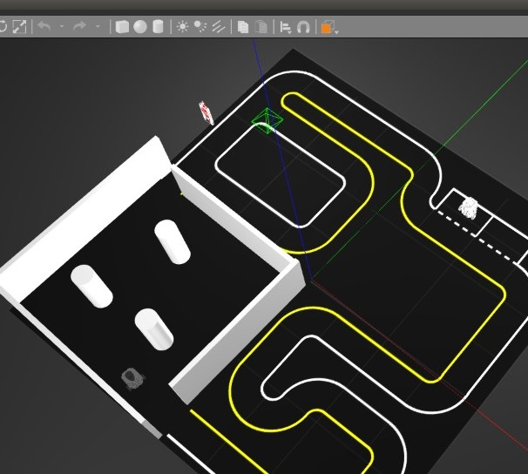
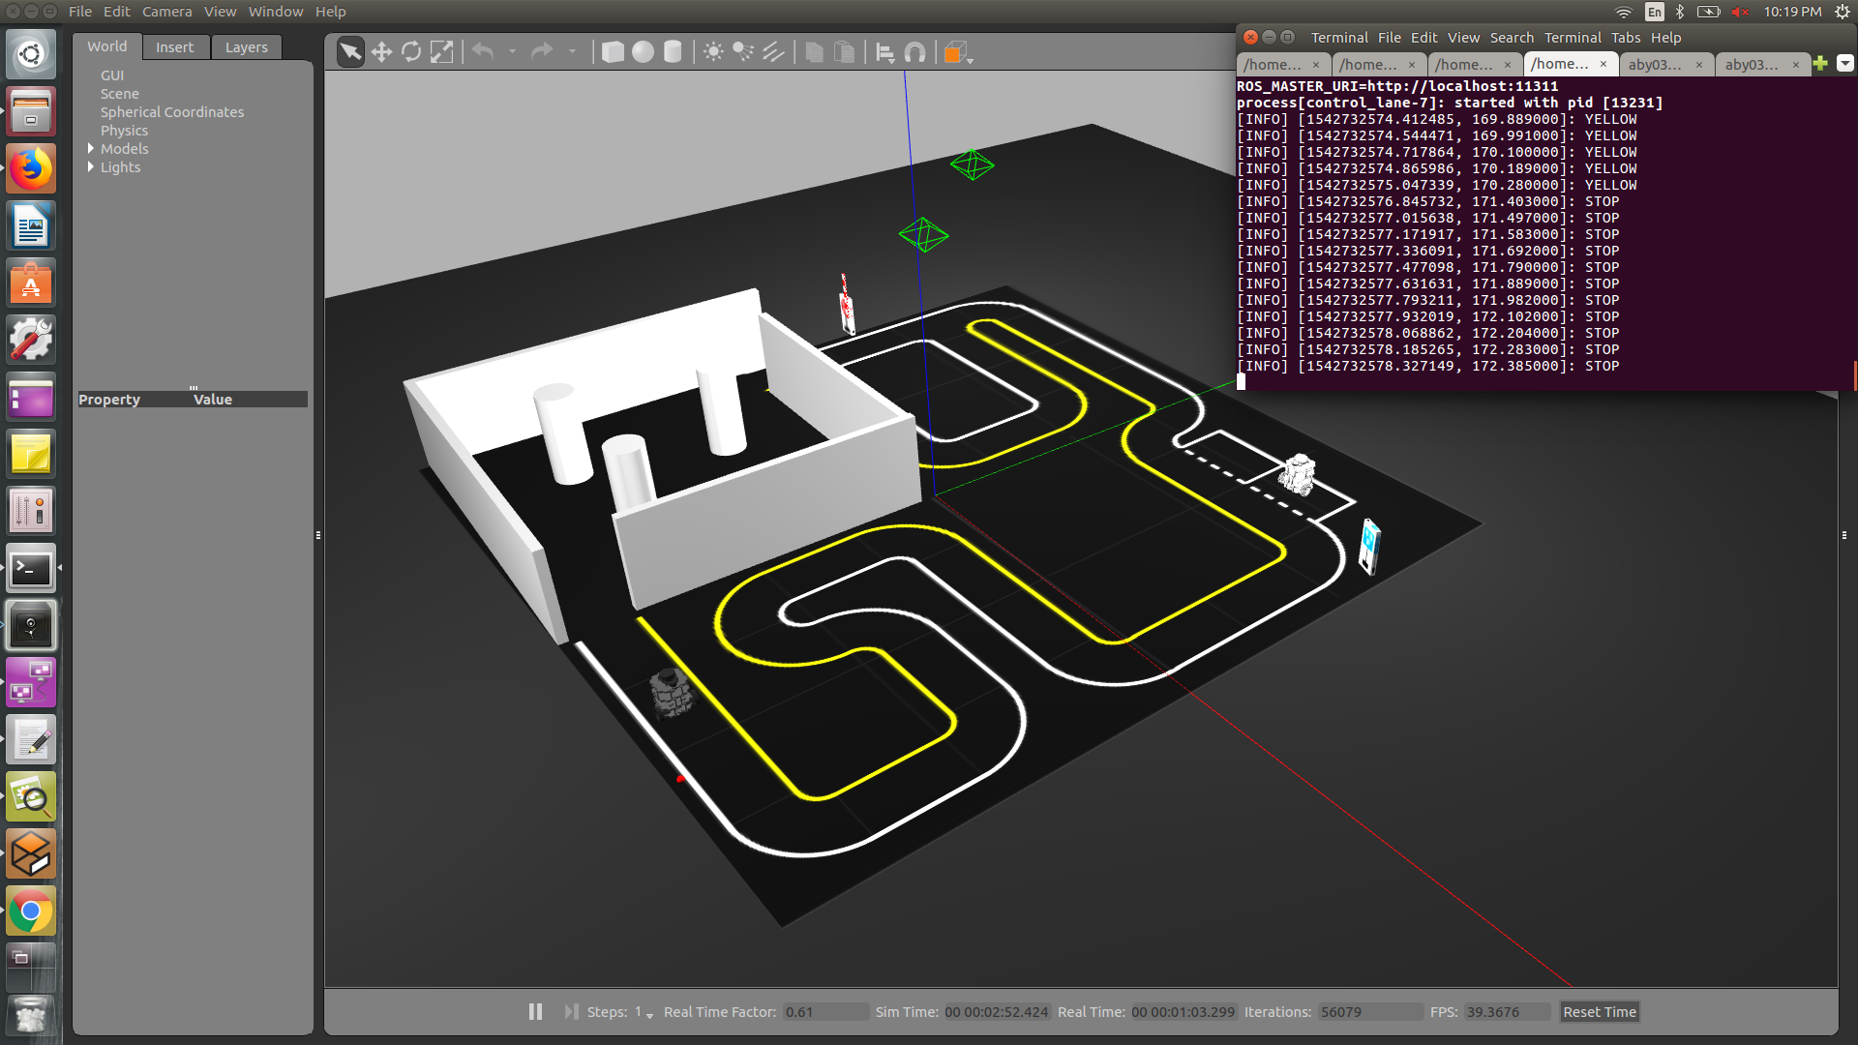
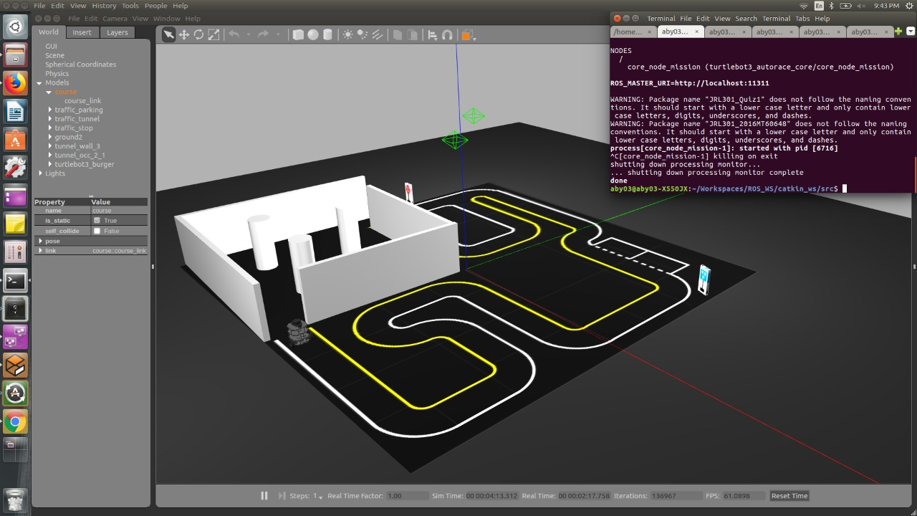
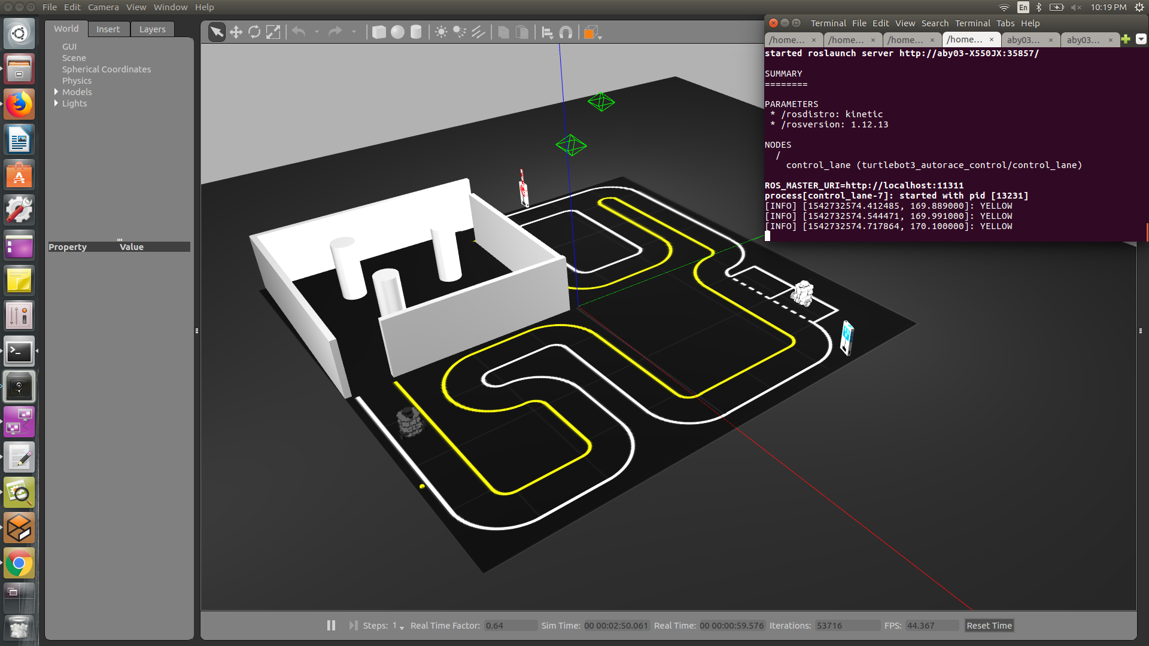
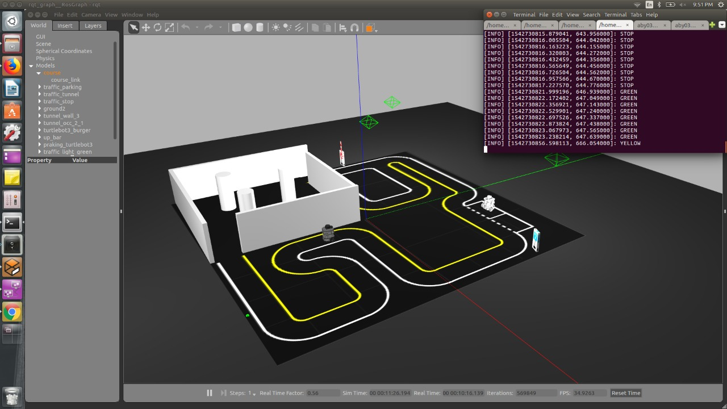

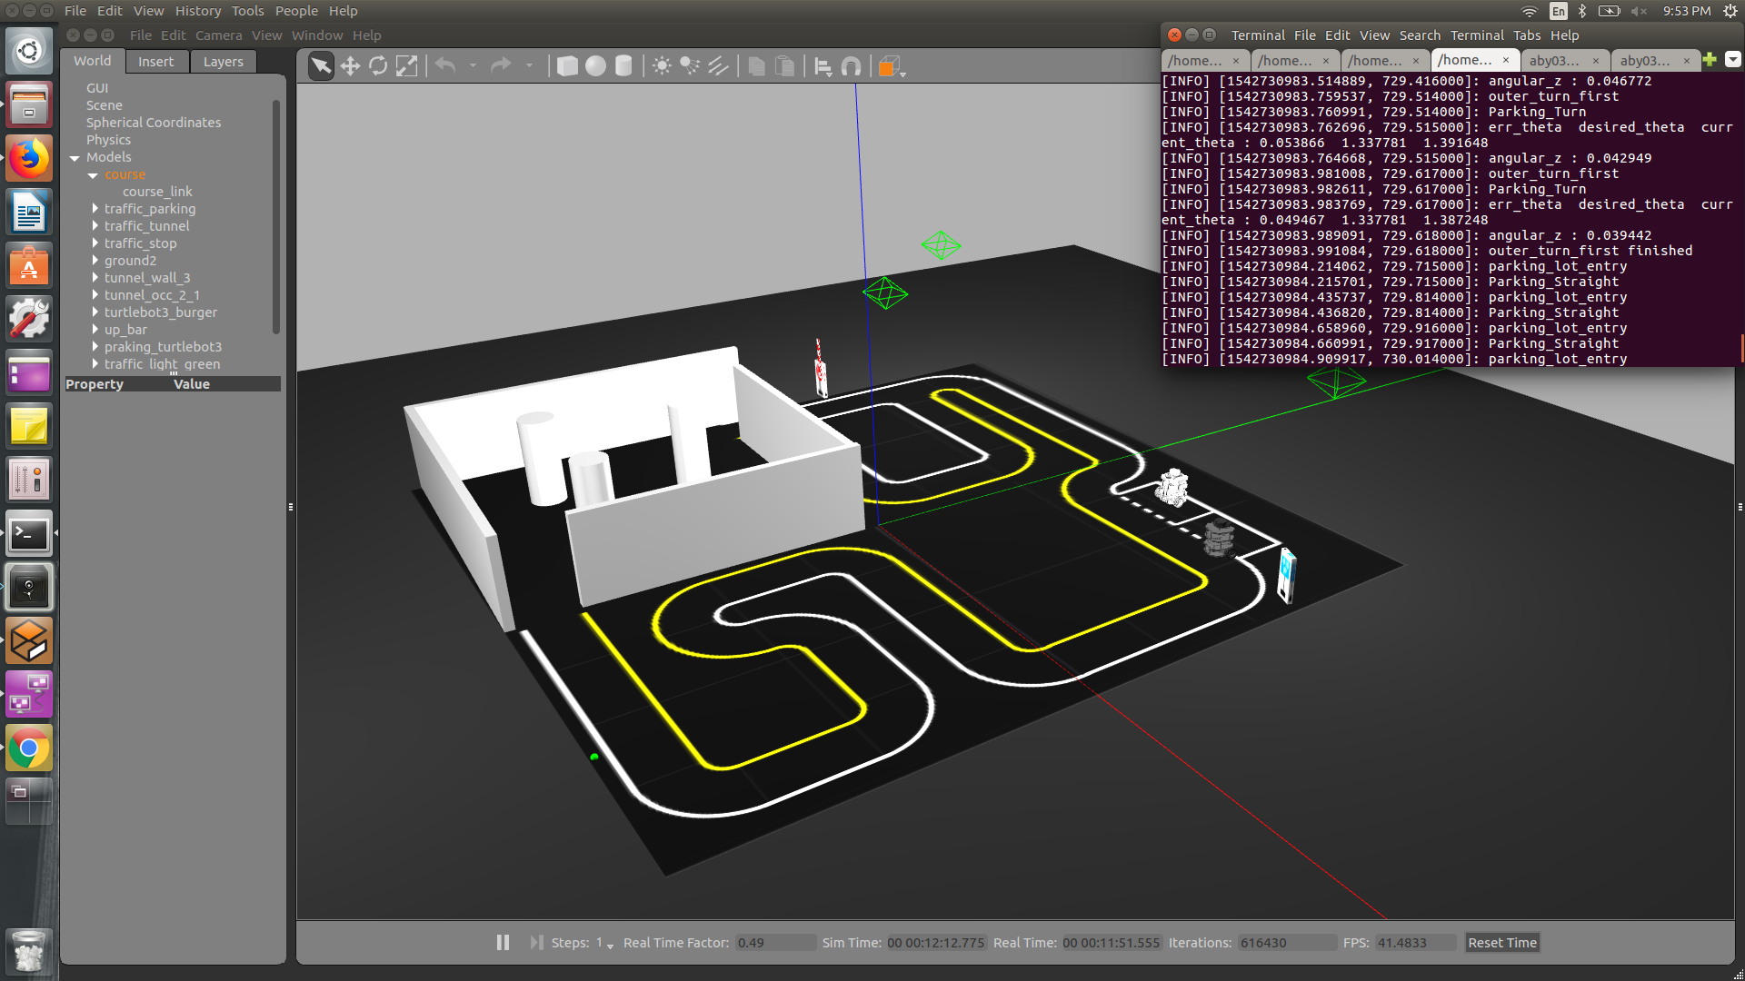
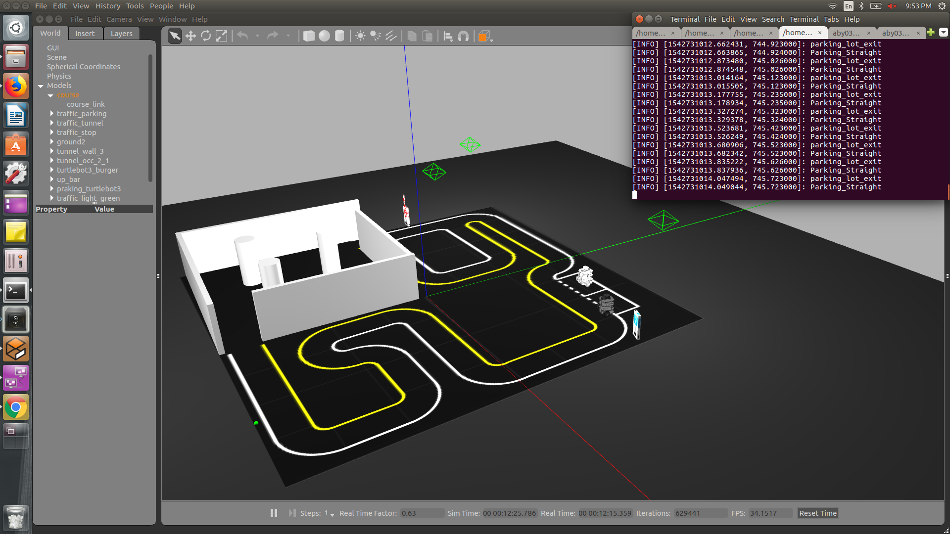
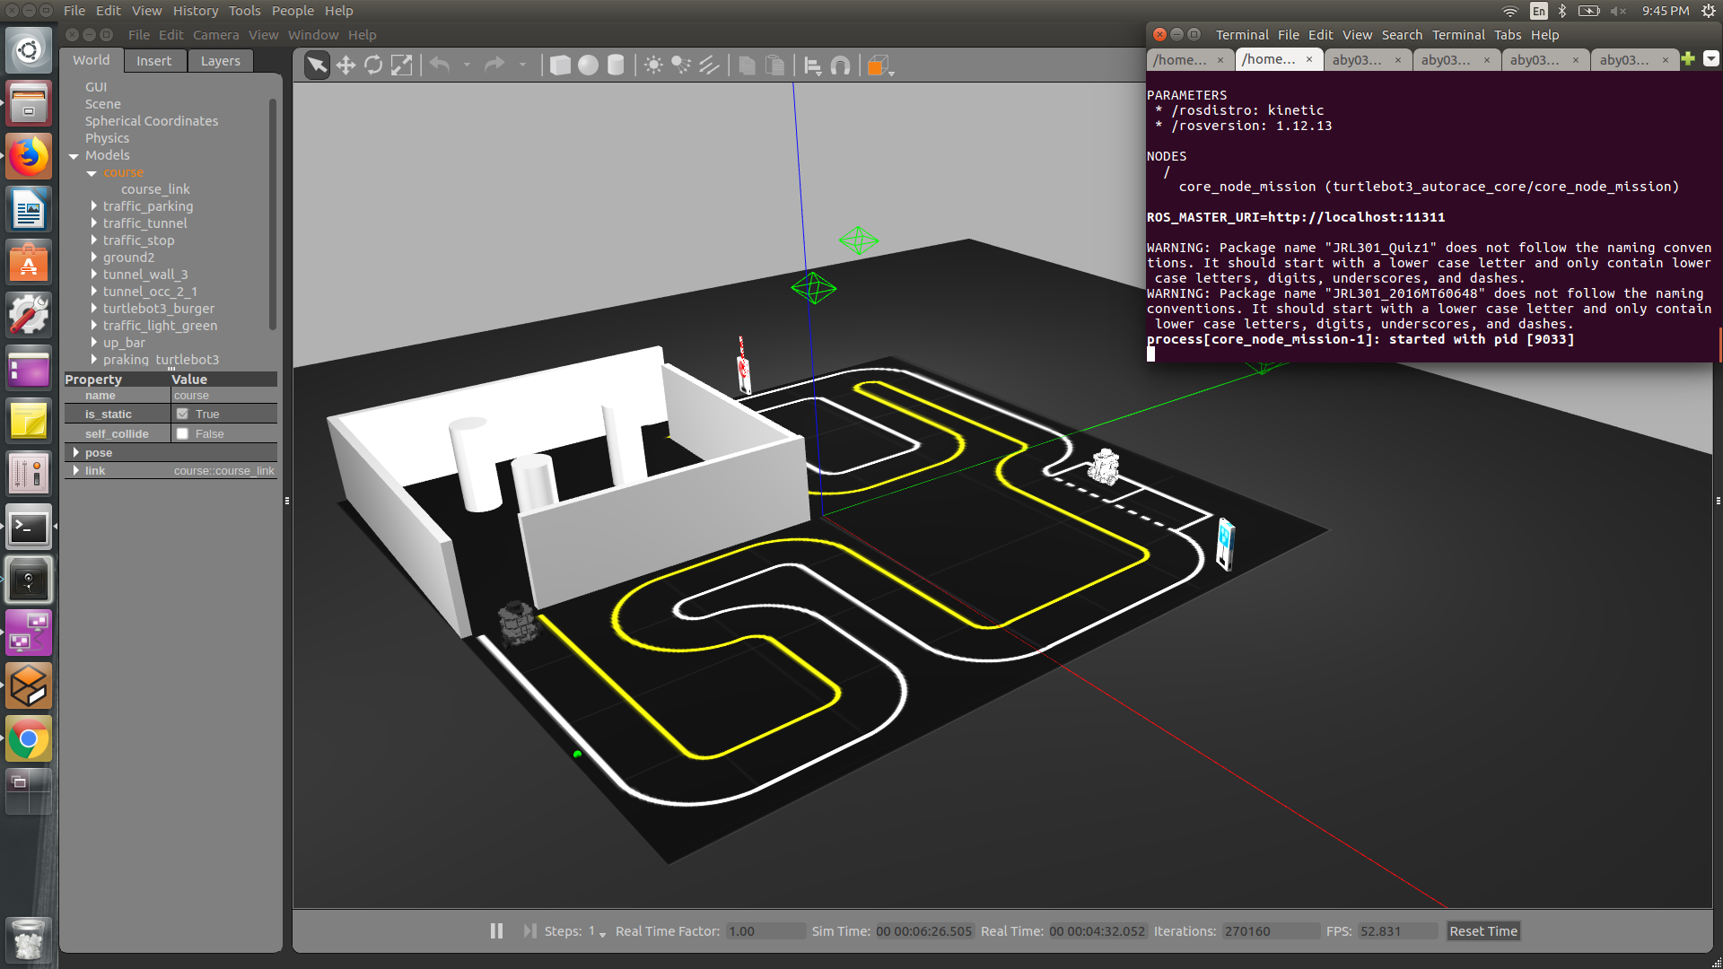
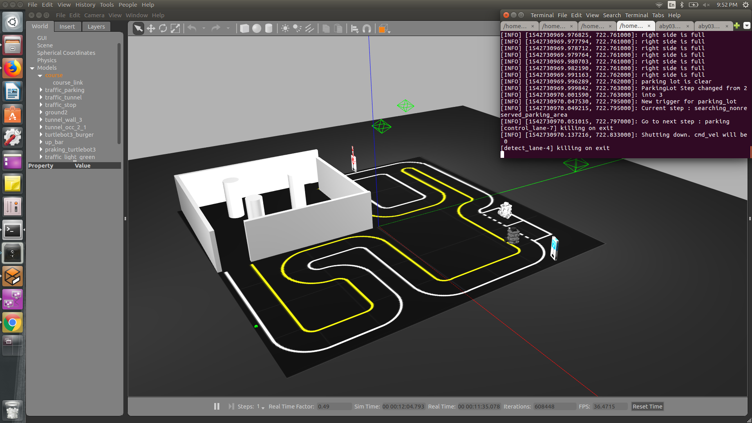
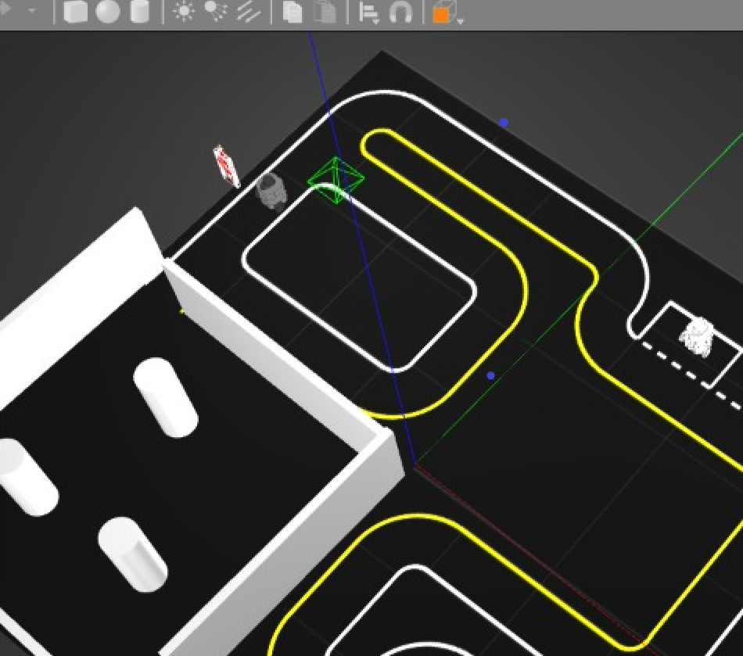
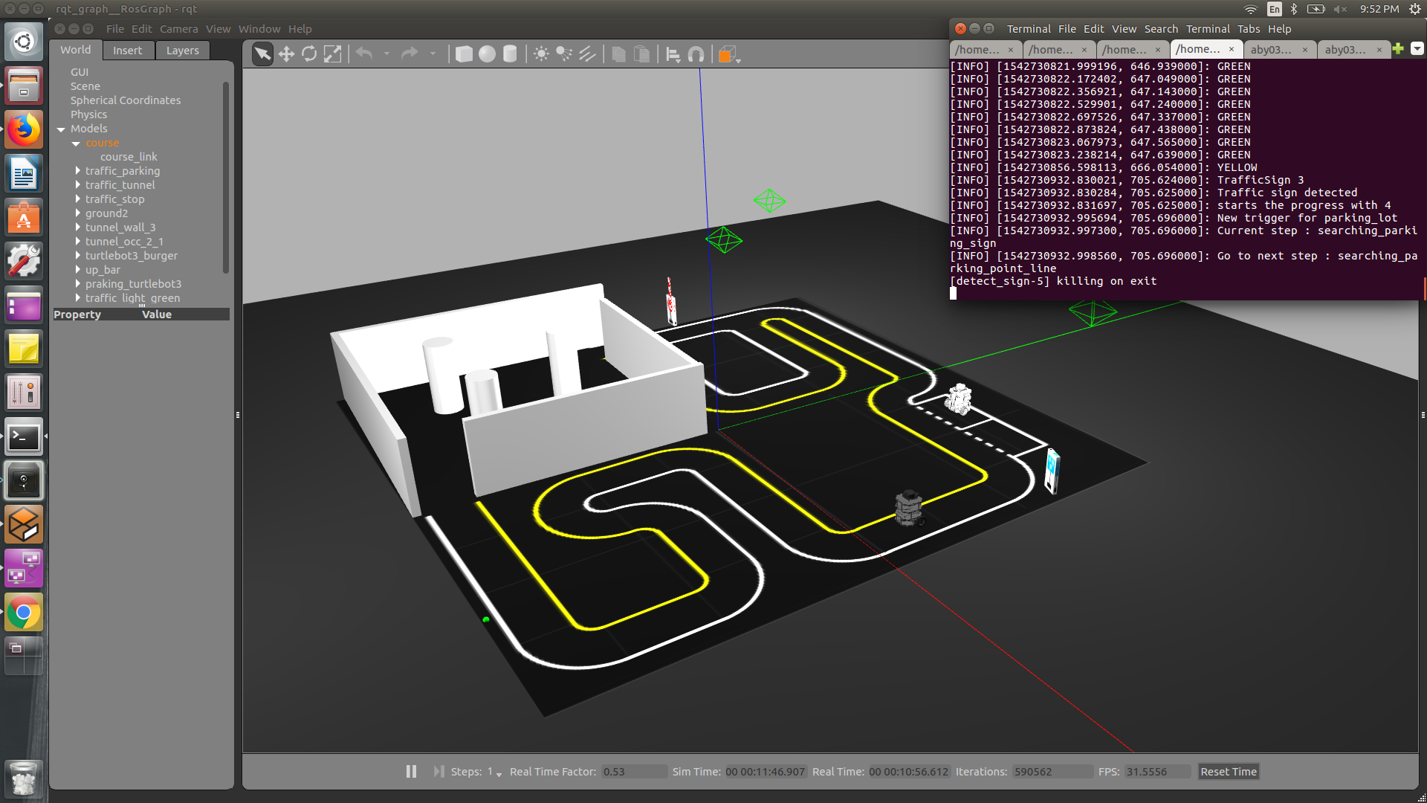
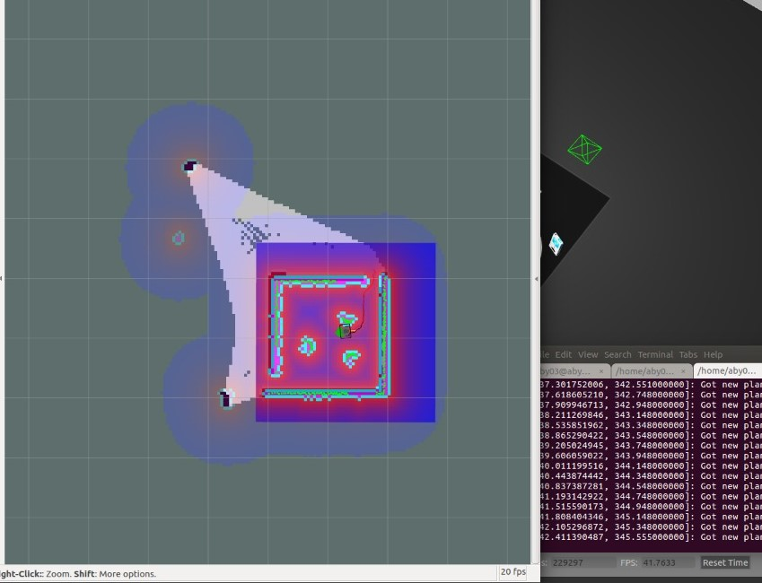
Flow of Code
Autorace Arena Initiated; Subtasks Spawned; Camera Calibrated
4 categories of nodes: Camera Calibration; Core Controller; Detection; Control
6 modes: Idle, Lane following, Traffic Signal, Parking, Level Crossing, Tunnel

Slide 4
Lane Detection
HSV coding of image
Threshold detection of yellow and white colours
Straight lanes traversed through the middle
Turns negotiated by projecting local motion path as a quadratic polynomial which is tangent to straight lane segments
Broad Areas: Vision

Slide 5
Identifying Traffic Signals
3 traffic signal colours primarily
Colour of signal identified by HSV thresholding
Turtlebot stops when signal is red, and then continues on green
Camera sampling rate imposes restriction on max speed of turtlebot
At high speeds, large range of “blindness”, undesirable
Bot worked well upto speed of 0.2 m/s.

Slide 6
Parking manoeuvre
Searching Parking Sign (SIFT)
Searching Parking Point Dashed Line (Hough Transform)
Searching for Non-Reserved Parking Area
Parking
Broad Areas : Vision, Control, ROS

Slide 7
Level Crossing
States of Level Crossing-
Searching Stop Sign
Searching Level
Watching level
Stop
Pass Level
Searching Stop Sign
Broad Areas: Image Processing(Vision), ROS
Blob Detection Using OpenCV
RGB to HSV
Geometry to calculate Distances

Slide 8
Navigation Through Tunnel
States of Level Crossing-
Searching Tunnel Sign
Go into tunnel
Navigation
Go out from Tunnel
Broad Areas: Vision, ROS
Sign identification by SIFT
LaserScan to obtain cost map of surroundings
Obtaining the shortest optimal path

Slide 9
Thank You

